Slide 1
MULTITHREADING

Slide 2
Multithreading:
This is a process of executing multiple threads simultaneously.
Thread is a lightweight subprocess, a smallest unit of processing.
Why multithreading??
Process of executing multiple threads simultaneously.
To maximize the CPU utilization time, there should be minimum idle CPU time.

Slide 3
Multitasking:
This is a process of executing multiple tasks simultaneously.
This can be achieved in two ways,
Process based multitasking
Thread based multitasking
Process based multitasking:
Each process have its own address in memory .i.e., each process allocate separate memory area.
Each process is heavy weight.
Cost of communication between process to process is expensive.

Slide 4
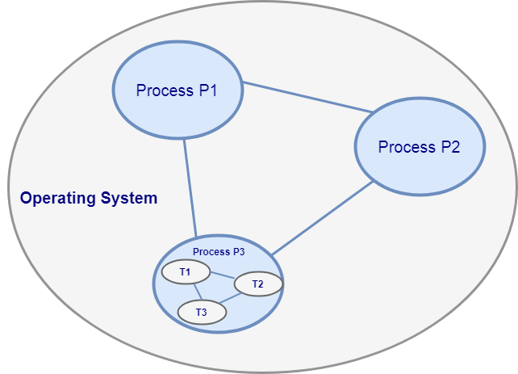
Thread based multitasking:
Threads share the same address and space.
Thread is light weight.
Cost of communication between Thread to Thread is not expensive.
Multithreading
Multitasking

Slide 5
Thread:
It is a lightweight sub process, the smallest unit of processing.
It use a shared memory area.
They don’t allocate separate memory area, so saves memory.
It weighs much less than other similar objects.
It utilizes a limited amount of RAM.
Thread is executed inside the process. There is context-switching between the threads.
Advantage:
It doesn't block the user because threads are independent and you can perform multiple operations at the same time.
You can perform many operations together, so it saves time.
Threads are independent, so it doesn't affect other threads if an exception occurs in a single thread.

Slide 6
Context-switching:
One process is in running state to execute its task, at that time another process with high priority is ready to execute. CPU always 1st execute high priority process, so here use Context Switching. It stop or pause the old process and store its state in kernel. After finishing new process of high priority, it continue the old process and finish it.

Slide 7
Priority of a thread in java:
In java, a thread’s priority is an integer in the range 1 to 10. The larger integer is the higher priority.
When create a thread, it inherits its default priority.
When multiple threads are ready to execute, the JVM selects and executes the runnable thread that has the highest priority.
If high priority thread stops or becomes not runnable, the lower priority threads will execute.
In case, two threads have the same priority, the JVM will execute them in FIFO(First In First Out) order.

Slide 8
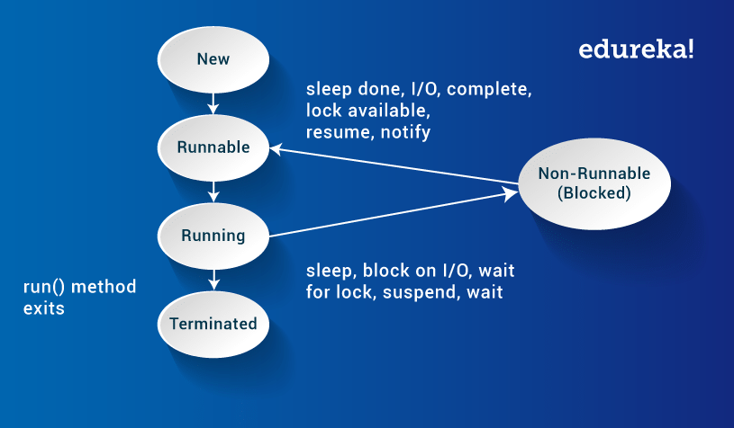
Life cycle of thread:

Slide 9
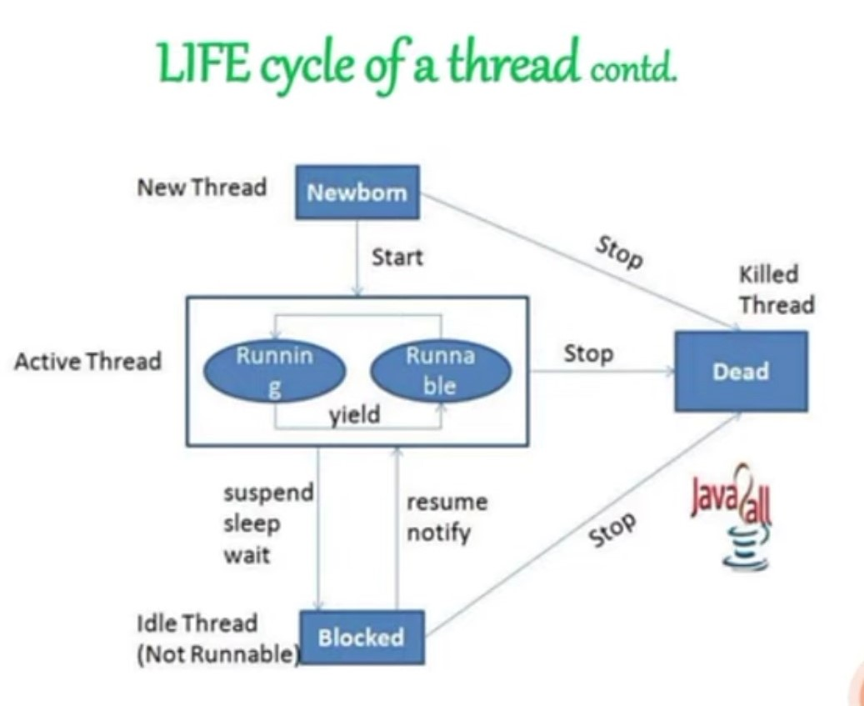


Slide 10
New:
If you create thread, that is in new state.
It is not yet scheduled for running.
Note:
Schedule it for running using start() method.
Kill it using stop() method.
Runnable:
The thread is ready for execution.
Waiting for the availability of the processor.
Running state:
Thread is executing.
The processor gives its time to thread for its execution.

Slide 11
Non-Runnable or Blocked state:
When the thread is alive, but it cannot be picked by the schedular for execution.
It is temporarily inactive.
It is achieved when we invoke suspend() or sleep() or wait() methods.
Terminated:
When the thread completes execution of its run() method, it goes into the Terminated/Dead state.

Slide 12
Methods
start() : used to begin the execution of thread.
run() : It execute the thread.
suspend() : puts the thread from running to waiting state.
resume() : suspended thread resumed using resume() method.
yield() : it stop the currently executing thread and will give a chance to other waiting thread of same priority.

Slide 13
join() : allows one thread to wait until another thread completes its execution.
sleep() : it used to halt the working of a thread for a given amount of time.
isAlive() : tests if the thread is alive.
->returns true if the thread is still running and not finished, otherwise returns false.
notify() : used to wake up a single thread. This method gives the notification for only one thread.
notifyAll() : used to wake up all threads. This method gives the notification to all waiting threads of a particular object.

